Slide 1
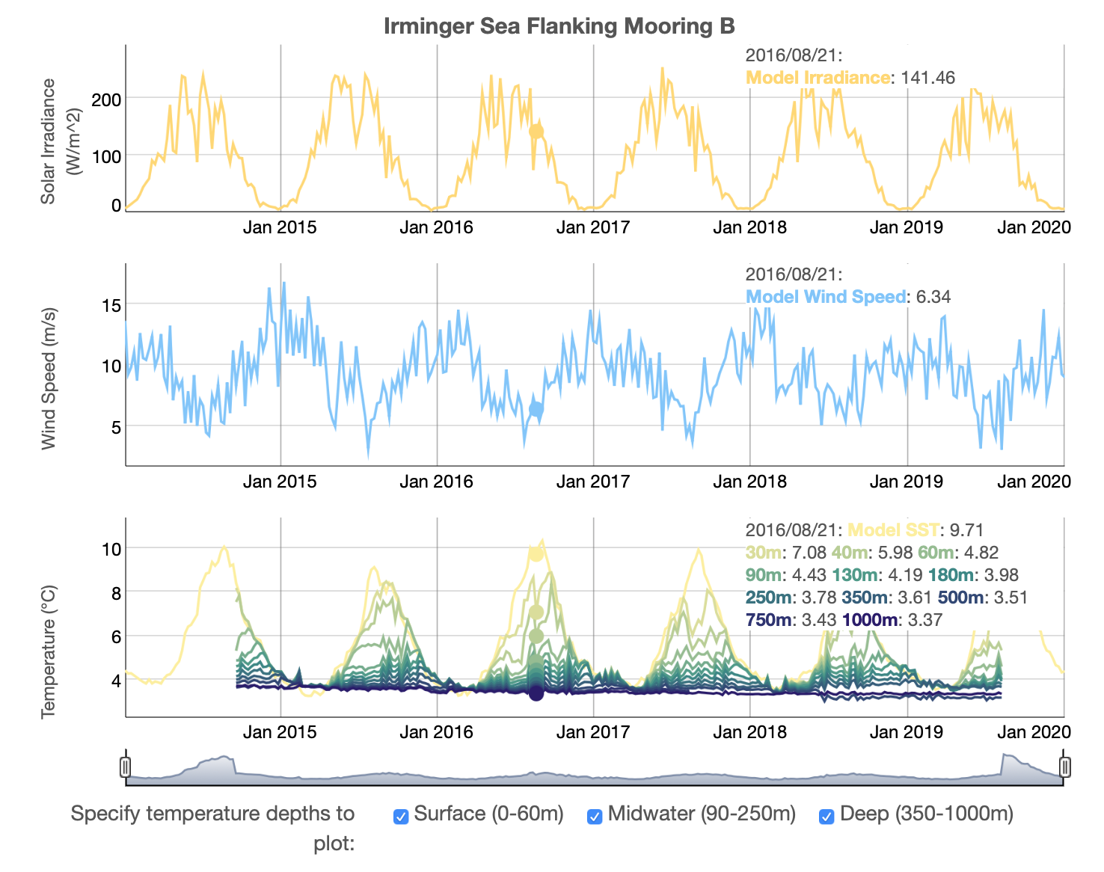
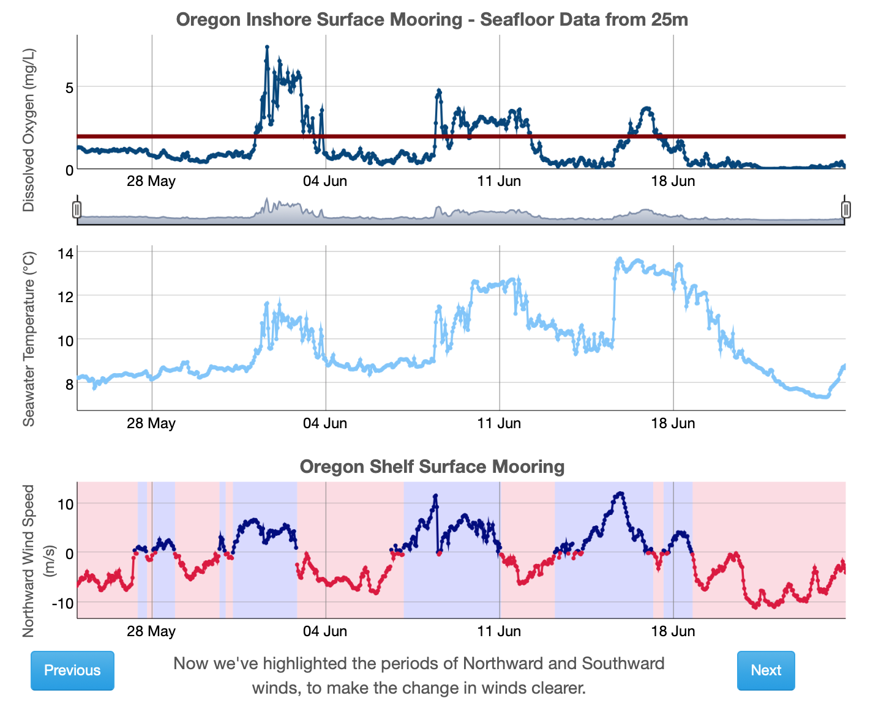
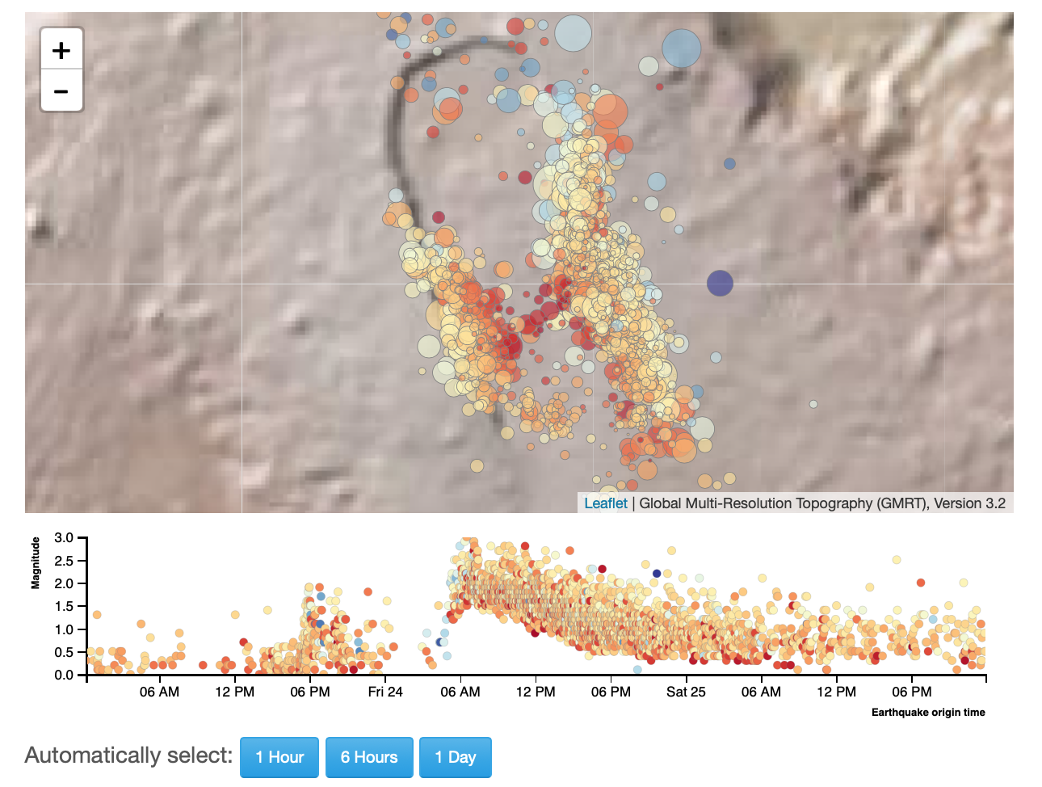
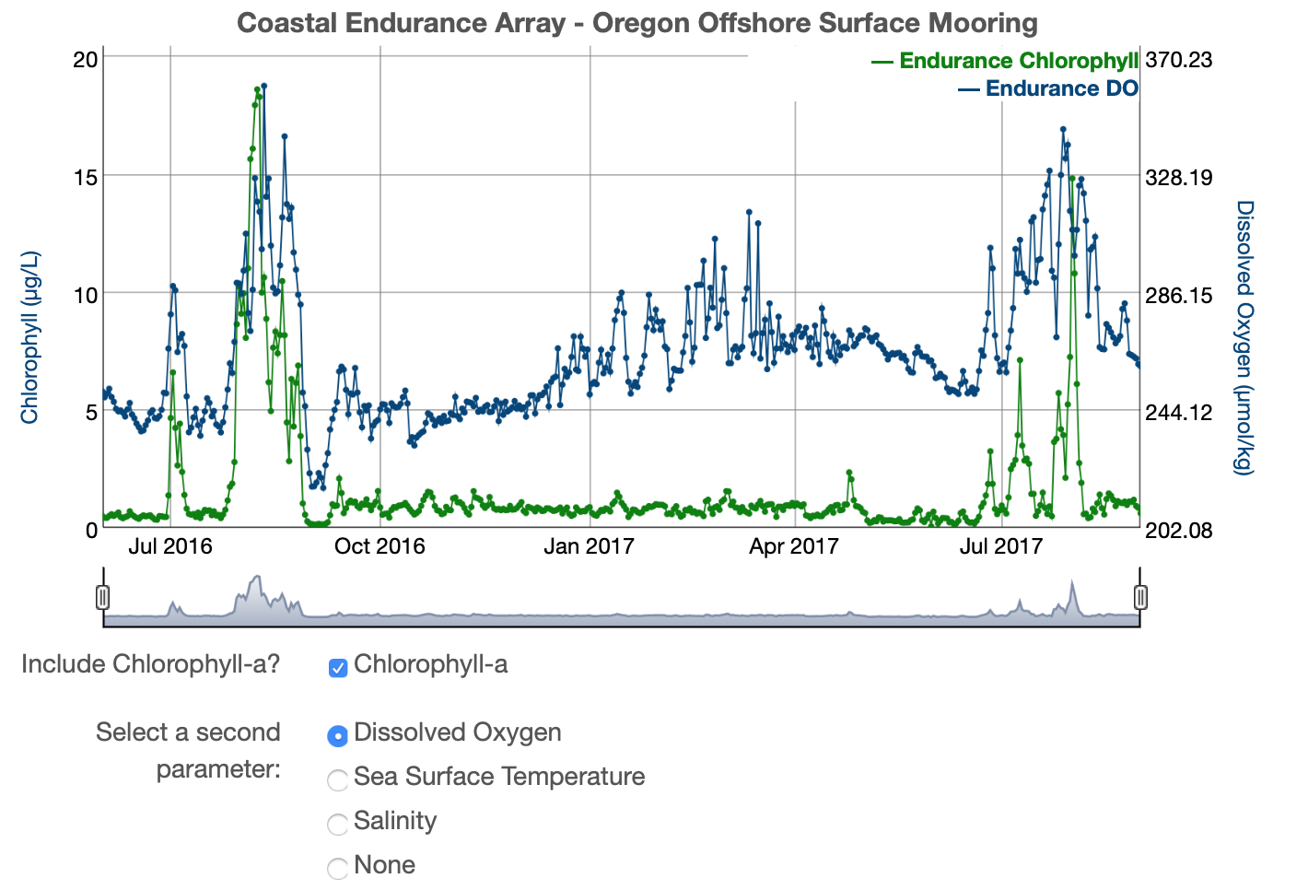
Reflections from the OOI Data Labs Community of Practice
ED51A-01
Janice McDonnell and Sage Lichtenwalner
Rutgers University
With Ellen Iverson, Ellen Altermatt, Anna Pfeiffer-Herbert, Denise Bristol, Dax Soule
datalab.marine.rutgers.edu
This project is supported by NSF Grant OCE-1831625

Slide 2

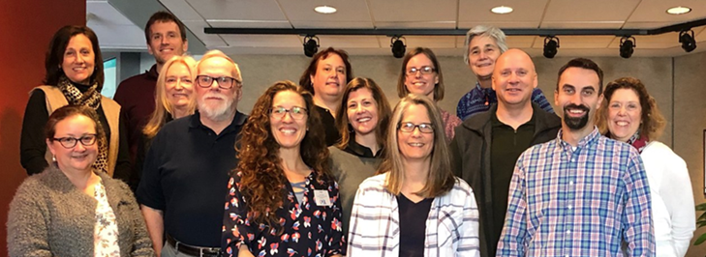
OOI Data Labs Project – Key Goals
Build a Community of Practice (CoP) of professors, interested in using OOI data with their undergraduate students.
Make OOI data more accessible to educators and students.
Notes:
The data labs project was funded in 2018 -
Our key goals were to build a Community of Practice for professors teaching undergraduate students – our focus was on exploring how we can use OOI data to teaching to improve data literacy skills and understanding of basic oceanographic themes and concepts. Our objective was to make OOI data more accessible to professors and students. It can be thought of a pilot study to explore data skills building through the use of real world data from the OOI.

Slide 3
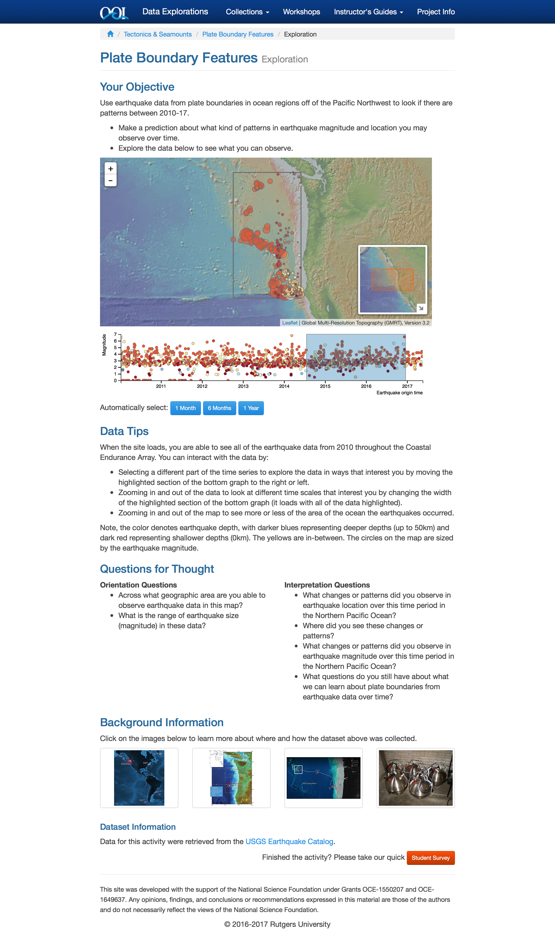
What is a Data Exploration?

Slide 5


Data Labs Resource Collection
Want a series of lab activities with built-in student assessments?
Want a ready-made lesson plan incorporating OOI datasets?
Want a modular set of activities that you can adapt?
Want to start from scratch using curated OOI datasets?
Want to introduce coding notebooks with OOI datasets?
Data Lab Manual
Lesson Plans
Data Explorations
Data Nuggets
Python Notebooks
Explore the collection: datalab.marine.rutgers.edu/data-labs/
Notes:
I removed the QR code from this slide since participants won’t explore until after the lightning talks

Slide 6
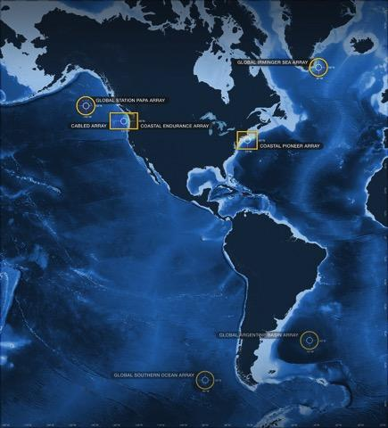
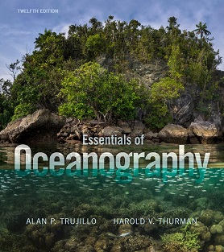
OOI Lab Manual alignment to Intro Oceanography curriculum
OOI science themes
and data availability
Topic | Chapter
Ocean geography Ocean technology | Lab 1: Introduction to the OOI, the collection of oceanographic data
Data skills for oceanography | Lab 2: Building data skills
Marine Geology | Lab 3: Plate tectonics and the seafloor Lab 4: Seafloor changes in a volcanically active setting
Ocean Chemistry | Lab 5: Investigating density stratification
Physical Oceanography | Lab 6: Waves generated by large storms
Biological Oceanography | Lab 7: Primary production Lab 8: Anoxic events
Lab Manual chapters
common Oceanography textbooks
Notes:
One of the un- intended project activities was our Data Lab Manual the idea came from a participant – Sid Mitra from at the time, Eastern Carolina University – now the Associate Dean of Academic Affairs at VIMS. We empowered a team pictured here to develop an open source lab manual that features the data explorations developed as part of the Data Labs project.
These are full developed lessons and interactive quizzes that help engage undergraduate students in oceanographic concepts with data sets from the OOI.

Slide 7
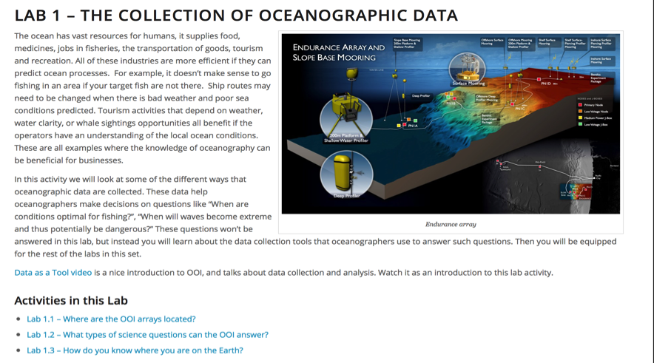
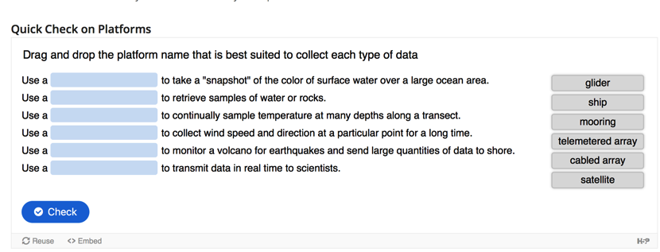
Lab Manual Structure
Each community developed chapter includes…
Full introduction
  Hook, brief background, key terms
3-4 data activities
  Orientation-interpretation-application-reflection model
Instructor guide
Student questions
  Instructor key (by request)

Slide 8
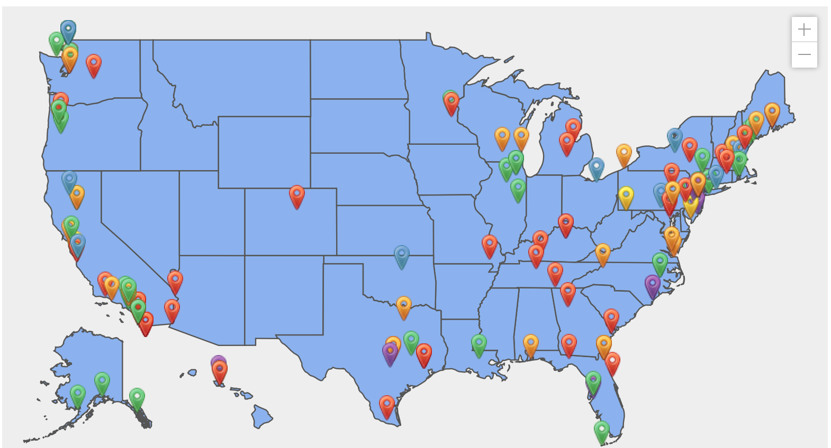
The OOI Data Labs Community of Practice
182+ members, 70% (n=133) involved in one or more Data Lab initiatives
Developers (56) – participated in one of our 2019 weeklong development workshops
Piloters (27+30+43) – attended one of our weekend pilot workshops in 2016-2017, or who have pilot tested our OOI Lab Manual
Fellows (11) – 2020 cohort
REU Mentors (14) – Faculty who helped mentor our 2020 Virtual REU students
Leaders & Staff – Members of the core project team
https://datalab.marine.rutgers.edu/community-map/

Slide 9
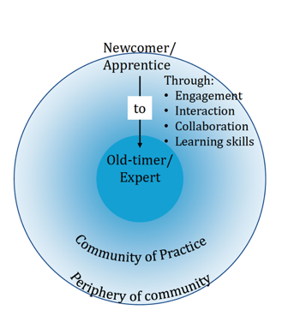
Building a Community of Practice
Of the 116 we worked intensively with in workshops:
19 delivered OOI DL webinars, presenting the DL they had developed during workshop
11 became DL Fellows
11 are designing and building the Data Lab Manual
9 became peer presenters at mini workshops
10 presented on OOI at Ocean Sciences Meeting in San Diego, CA
13 volunteered to be an OOI Virtual REU mentor
40 participated as Lab Manual testers
The community is growing! 34 more at OSM24
Notes:
The Lab Manual became a boundary object that everyone could feel like they helped to create collectively and for the greater good of the community. From that work – we truly started to build a COP. Those who started as newcomers on the periphery of the community are now CoPIs on the new project!

Slide 10
Evaluation & Impacts
Conducted by Dr. Ellen Altermatt, SERC at Carleton College
The purpose was to:
better understand current perceptions of and practices in using large, real-world oceanographic datasets in undergraduate classrooms,
assess levels of involvement in past and current OOI Ocean Data Labs initiatives,
examine the impact of participation in these initiatives on faculty teaching and perceptions of community belongingness, and
assess planned levels of future involvement and to understand how current resources might better meet community needs.
Notes:
Don’t have time to review all these results But wanted to share some of them – because scientists like data and this is our data. SERC evaluated the project with a reach survey to all of our participants. The purpose was to (1-4) we can focus today on 3

Slide 11
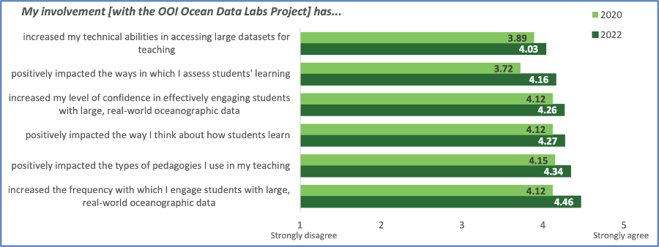
How has involvement in the OOI Data Labs Project influenced teaching?
Notes:
Comparison between 2020 and 2022 mean ratings of the degree to which participants’ involvement with the OOI Ocean Data Labs Project has influenced their teaching. When asked to report the degree to which their involvement in the Data Labs project influenced their teaching and perception of themselves as instructors, participants reported positive impacts in engagement and confidence in using authentic datasets as well as other areas including teaching, thinking about how students learn. Means for all items > 4 on a scale of 1 (strongly disagree) to 5 (strongly agree).
Respondents, as a group, reported that involvement with the OOI Data Labs project had positive impacts on engagement and confidence in using authentic datasets as well as on other areas teaching (e.g., thinking about how students learn) with means for all items > 3.70.
The highest means emerged for two items tapping the degree to which respondents felt part of a community of educators interested in using OOI data in their teaching (mean = 4.20) and interested in changing how they teach to improve student outcomes (mean = 4.24).

Slide 12
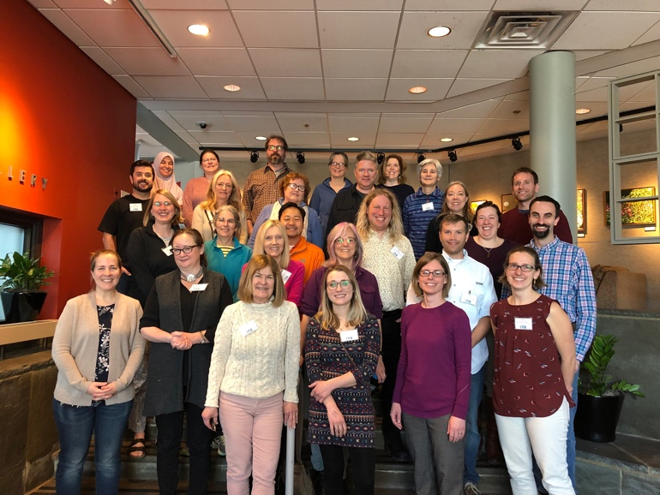
OOI Data Labs 2.0 (2023-2025)
Project Goals
Continue to build and support the OOI educator community
  Especially MSI, 2YC, PUI and R2
  Special focus on the Mid Atlantic
Develop “next level” activities
  Fill in gaps in the existing OOI Data Labs manual
  Domain-specific and level-appropriate programming notebook-based activities

Slide 13
Data Labs 2.0 Timeline
Refresh and Build Database (now!)
Ocean Sciences Meeting (workshop and session)
Feb 2024
Needs assessment and development workshop
Spring 2024
Development workshop (python applications)
Spring 2025
Mini One Day workshops at strategic conferences and meetings (on-going)
Join our mailing list for updates!

Slide 14
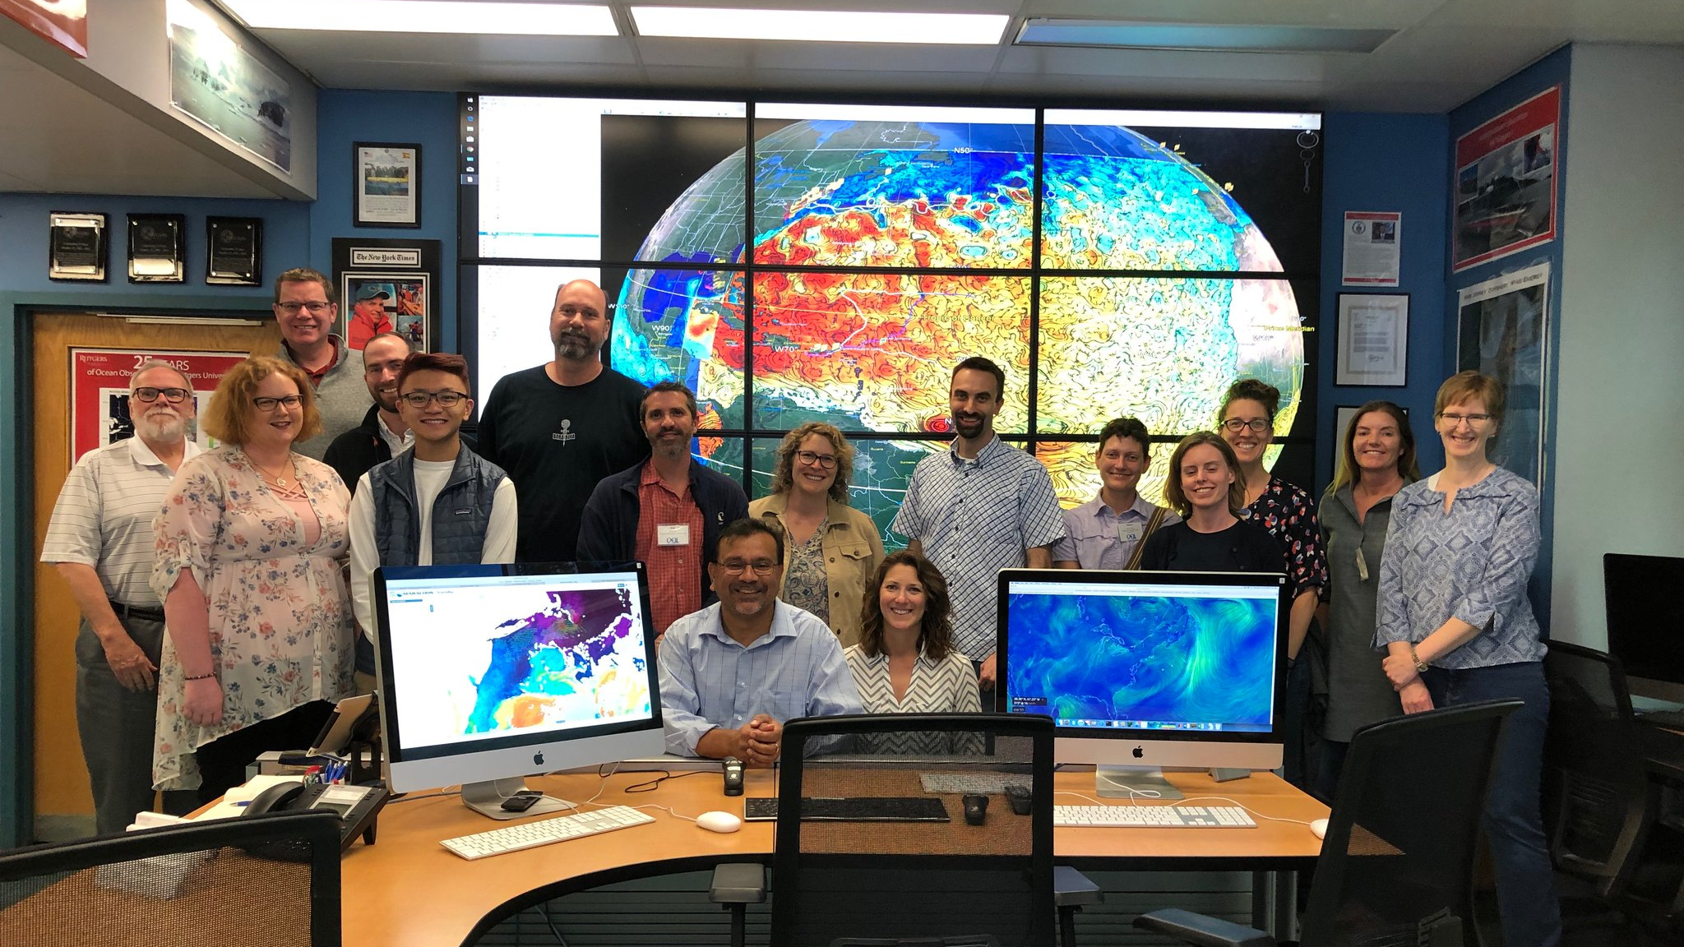


Thank you! datalab.marine.rutgers.edu

Slide 15
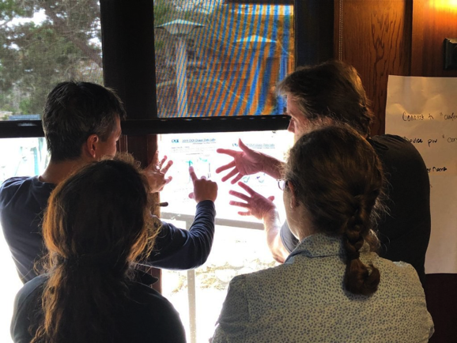
Goals of the OOI Lab Manual
Build data literacy and critical thinking skills in undergraduate students using authentic (“messy”) scientific data
Visualize data in a user-friendly, interactive and authentic way
Engage students with data activities that reinforce student confidence in scientific questioning, data analysis, and synthesis
Provide a real-world context for key concepts in oceanography

Slide 16
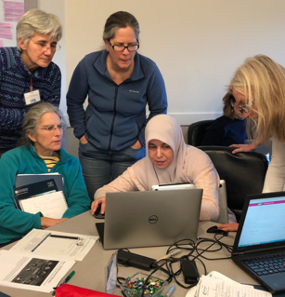
Survey Facts
Sent to updated database of 590 professors
Completed by 145 individuals (22.8% response rate).
Analysis focused on n=133
  130 who indicated that they had taught an undergraduate-level oceanography course (or a related course with substantial oceanographic content) in the past two years.
  An additional 3 respondents indicated that, although they had not recently taught this type of course, they planned to do so in the next two years.
Notes:
A little more about the survey instrument

